Slide 1

Stock Price Prediction using Reinforcement Learning
TEAM MEMBERS :
M.REESWANTH - 21BCE9646
K.MANOHAR - 21BCE9466
B.CHAITANYA - 21BCE9968

Slide 2
Problem Statement
Predicting stock prices accurately is a challenging task due to the dynamic and complex nature of financial markets. Traditional methods often struggle to capture non-linear patterns and sudden market shifts, leading to unreliable predictions. This project aims to develop an advanced data-driven approach that learns from historical price data and market indicators to enhance prediction accuracy. By leveraging this approach, we seek to identify market trends and patterns that traditional models miss, providing more reliable insights for investment decisions. The goal is to create a system that can adapt to changing market conditions, assisting investors in making informed choices and managing risks in an unpredictable financial environment.

Slide 3

Motivation
The motivation for this project arises from the challenges of predicting stock prices in volatile financial markets. Traditional models often struggle with the complex, non-linear nature of market behavior, leading to inaccurate forecasts and missed opportunities. With the increasing availability of historical data and advanced computational techniques, there is potential to develop more sophisticated models that adapt to market dynamics. This project aims to enhance prediction accuracy, aiding investors in making informed decisions and improving their chances of success in a competitive landscape.

Slide 4
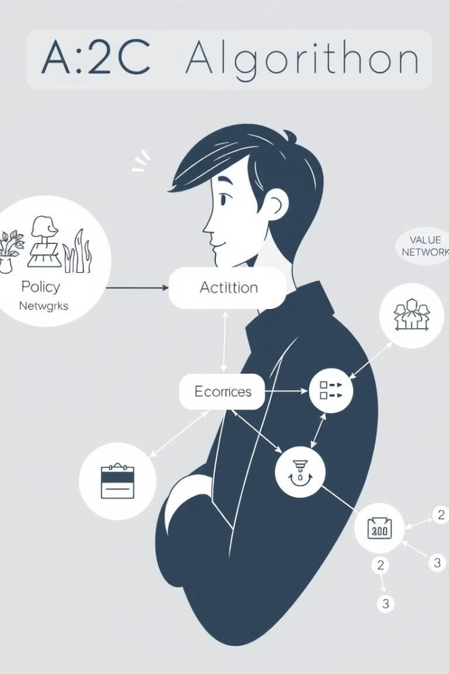
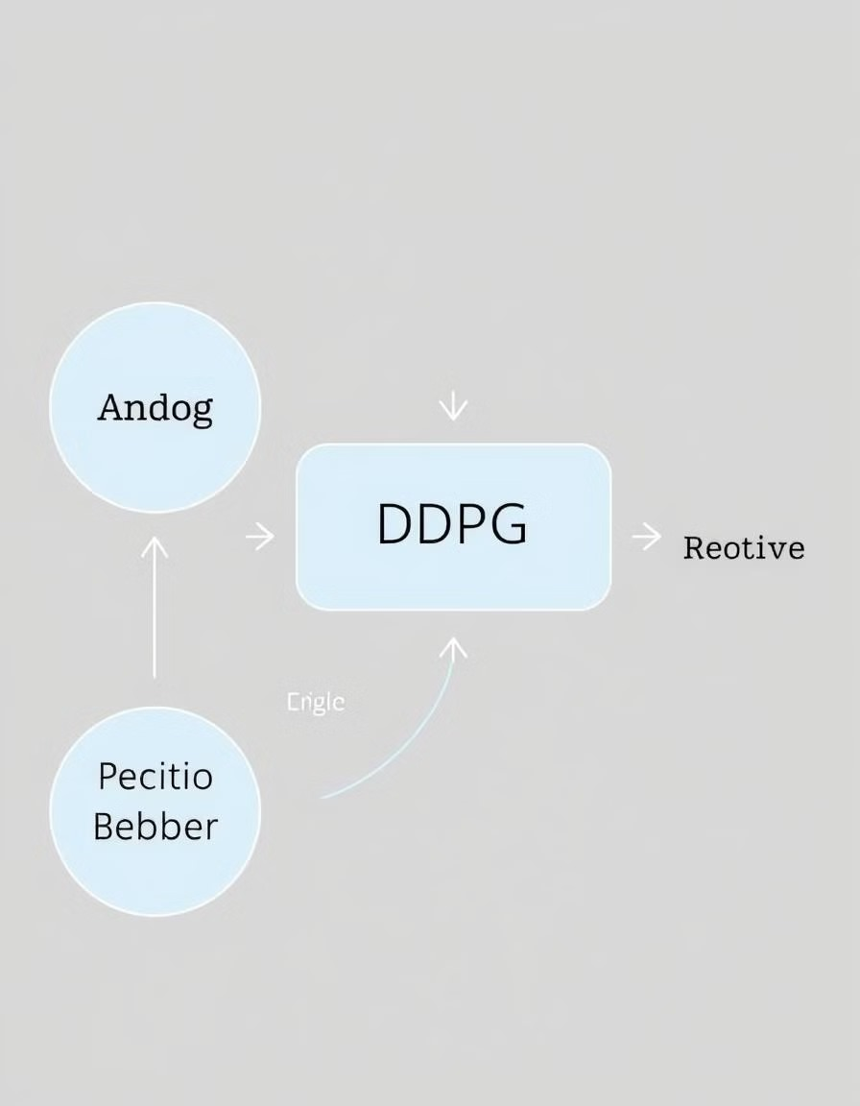
Reinforcement Learning Models for Stock Price Prediction
A2C Model: Advantage Actor-Critic.
an Actor network that predicts the probability distribution of actions (Buy, Sell, Hold)
a Critic network that evaluates the current state by predicting its value. The A2C model is well-suited for capturing the stochastic nature of financial markets, enabling effective decision-making.
DDPG Model: Deep Deterministic Policy Gradient (DDPG) employs actor-critic networks but focuses on continuous actions, allowing for more nuanced decision-making in the stock market.
The Critic network evaluates actions by taking the predicted action as input, making DDPG suitable for capturing subtle market trends in real time.
Hybrid Model: This model combines A2C and DDPG by averaging their predictions, leveraging the stochastic policy of A2C and the continuous action space of DDPG. This hybrid approach provides a balanced and adaptable method for predicting stock movements, aiming to capture a broader range of market dynamics.

Slide 5
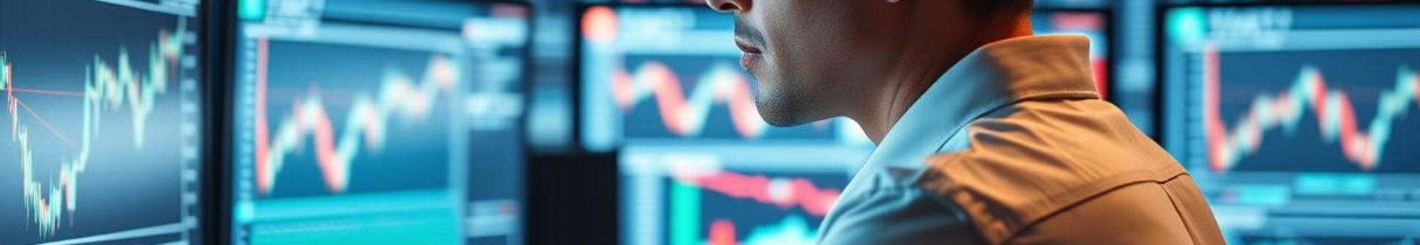
Application of A2C and DDPG in Real-Life Stock Trading
Stock Trading:
Market Prediction
Finance and Trading
A2C can be used to develop trading agents that learn optimal buying, selling, and holding strategies by continuously interacting with the market environment, improving decision-making based on historical data.
A2C and DDPG can be used to predict future market trends, helping investors make informed decisions.
DDPG is applied to algorithmic trading, enabling agents to make continuous trading decisions by learning from market data and optimizing profit strategies.

Slide 6
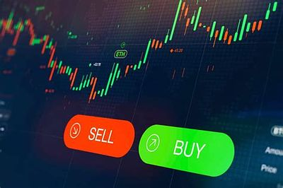
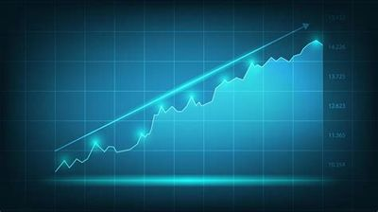
Conclusion
We successfully implemented A2C and DDPG algorithms to achieve high accuracy in buy, sell, and hold predictions for stock prices. By utilizing historical data and advanced modeling techniques, it enhances prediction accuracy and adapts to the dynamic nature of financial markets. The integration of these models provides a strong framework for capturing complex market patterns, leading to more informed investment decisions. Ultimately, the findings contribute valuable insights for investors and financial institutions, improving their strategies in stock trading and risk management.

